Slide 1
Growth Models

Slide 2
Agenda
Start | End | Item
 |  | Gompertz Curves
 |  | Bass Models
 |  | SIR

Slide 3
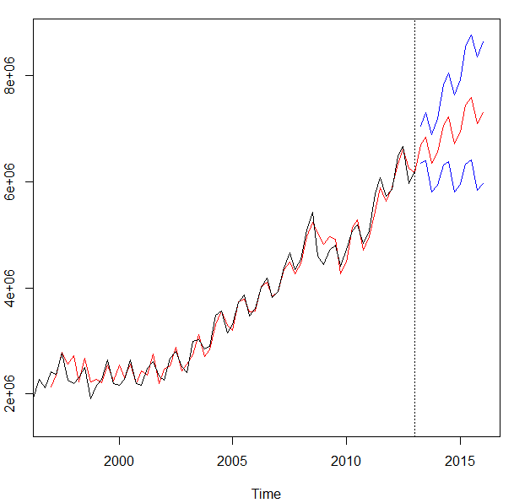
Growth Models are a form of time series forecasting
Model Based Methods
Holt Winters
Time Series Decomposition
Book Chapter 17
Regression Based Forecasting
Data Driven Methods
Forecasted value at period “n” is equal to some interactions of x-variable inputs

Slide 4
Model Based
Model Based approaches do not have x-variable inputs.
Use statistical, mathematical or other scientific model to approximate a data series.
Parameters of the model are learned in training then used to generate forecasts or more specifically the behavior of the phenomena.
Can be used with few data points
Remember how we only had the time series to get level, trend & seasonality?

Slide 5
When to use model vs data driven forecasting
Data Driven
Needs trustworthy historical data
Variables are engineered as inputs i.e. month dummy variables lagged x days as inputs
Apply a machine learning method like XGB
Data driven works when there is historical pattern, & data can be trusted. Model based approaches work when there is no/limited/lots of noise in the data.

Slide 6
When to use model vs data driven forecasting
Model Driven
Needs fewer data points
Lots of variability that is not easily quantifiable
Assumptions can be made for curve parameters
Data driven works when there is historical pattern, & data can be trusted. Model based approaches work when there is no/limited/lots of noise in the data.

Slide 7
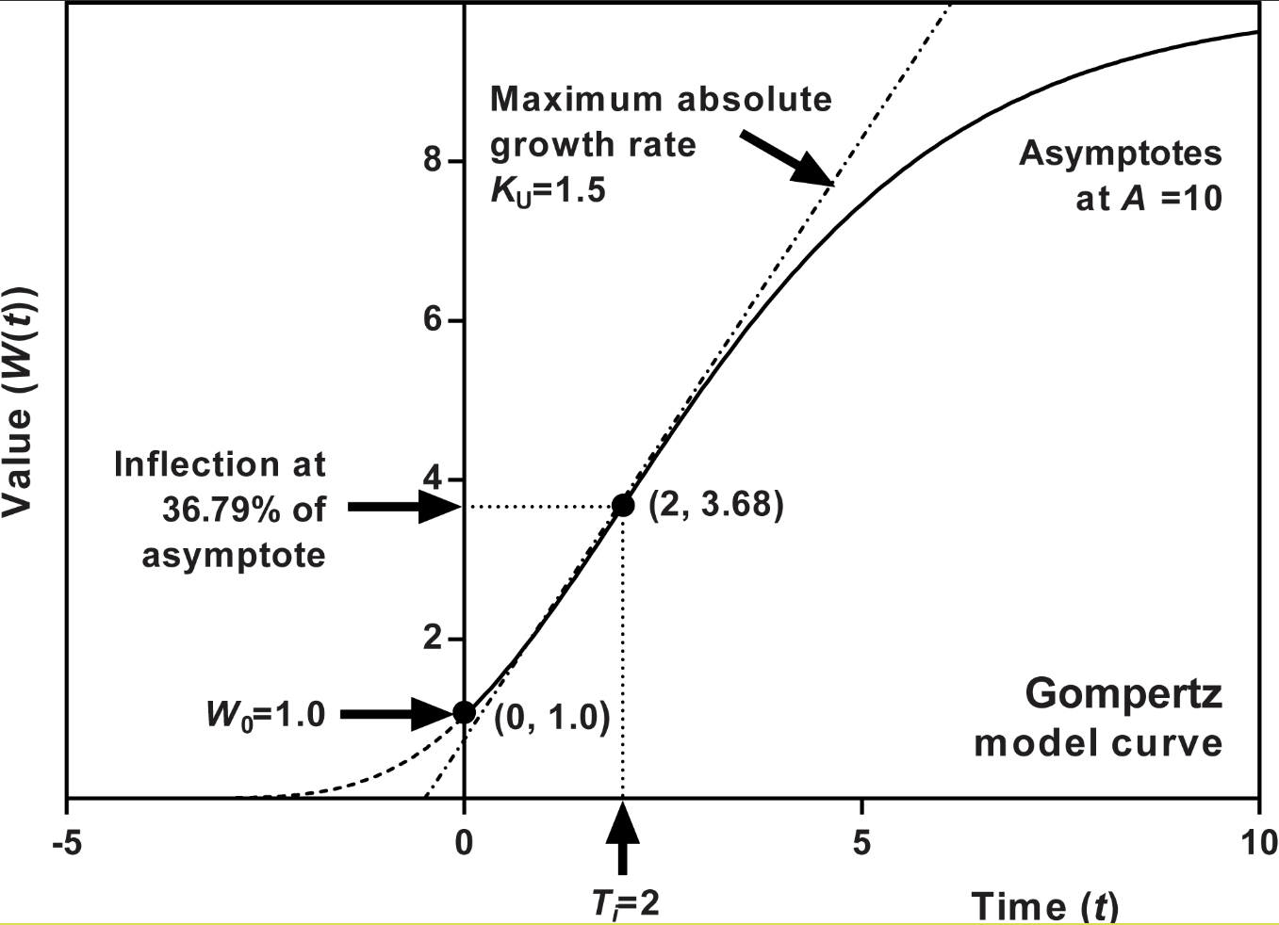
Gompertz Growth Curves
Gompertz Specifics
New Product Forecasting
Tumor Growth Modeling
Assumes the population doesn’t change (no natural birth/death rates)
Can help with planning on completely new item forecasting with only a few starting points & an upper limit to the population (market size potential)

Slide 8
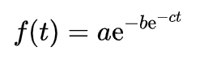
Gompertz Growth Curves
Double exponential
Where:
a = asymptote
b = displacement on x-axis
c = maximum growth rate
e = 2.71828

Slide 9
Gompertz Growth Curves
Double exponential
Where:
a = asymptote
b = displacement on x-axis
c = growth rate
e = 2.71828
Biz:
a = market potential at the last period
b = how aggressive is market adoption over time
c = slope or adoption rate
e = 2.71828

Slide 10
Gompertz Growth Curves
Gompertz Specifics
Mkt potential
Biz:
a = 50

Slide 11
Gompertz Growth Curves
Gompertz Specifics
Biz:
a = 50
b = 5
Displacement

Slide 12
Gompertz Growth Curves
Biz:
a = 50
b = 5
c = 0.5 (rise / run) =
50 widgets for /25 periods
e = 2.71828
Slope

Slide 13
Let’s practice
A_gompertzCurve.R

Slide 14
Agenda
Start | End | Item
 |  | Gompertz
 |  | Bass Models
 |  | SIR

Slide 15
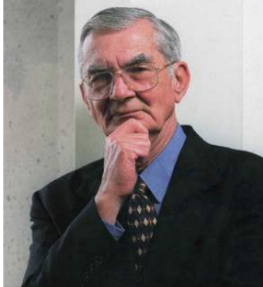
Not a meme…really Frank Bass (1926-2006)
A New Product Growth Model Consumer for Durables, Management Science, Vol. 15 (January 1969)
One of 10 papers in the selection Top 10 Most Influential Papers published in the 50-year history of Management Science (2004)

Slide 16
Two input parameters
Rates of Innovation
Some people buy the product because of product features, marketing etc.

Slide 17
Two input parameters
Rates of Imitation
Some people buy the product because they learn about others experience (word of mouth, ratings etc)

Slide 18
Two input parameters (plus total market)
Rates of Innovation
Some people buy the product because of product features, marketing etc.
Rates of Imitation
Some people buy the product because they learn about others experience (word of mouth, ratings etc)

Slide 19
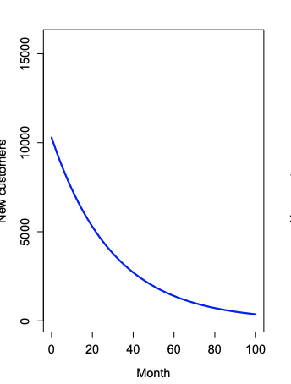
Innovator Behavior
Smaller total number
Steep decline
“People enticed & willing to take a chance”

Slide 20
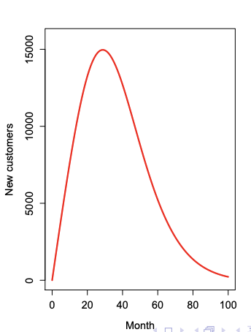
Imitation Behavior
Larger total number
Steep incline as they learn from innovators
“People eventually won over but total market is limited so a decline occurs eventually”

Slide 21
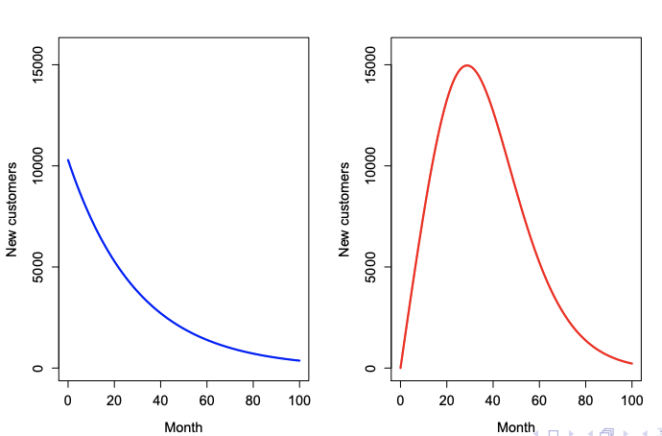
Side by Side
Total new customers is the sum of these two parties

Slide 22
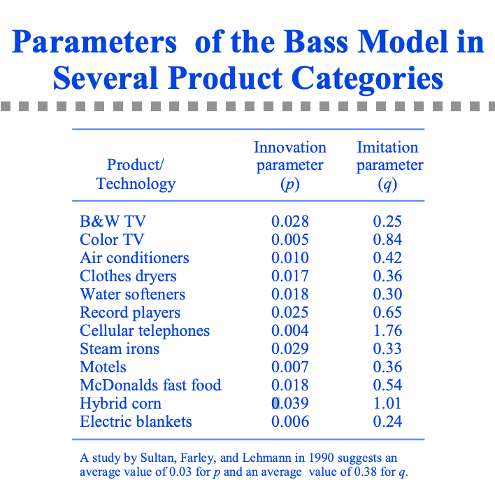
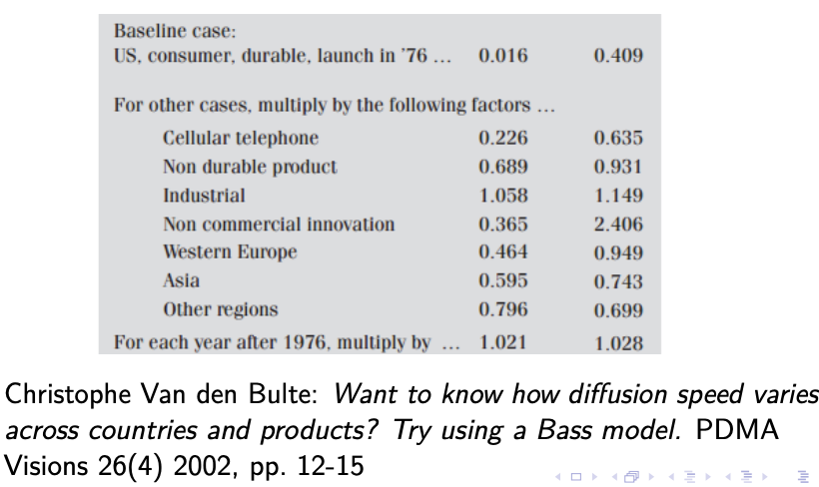
BASS Models Find analog adoption parameters
P
Q
Takes some digging to get these for an analog product/service & there are differences!

Slide 23
Let’s Practice
B_newProdForecasting.R

Slide 24
Agenda
Start | End | Item
 |  | Gompertz
 |  | Bass Models
 |  | SIR

Slide 25
SIR has 3 states of nature
Susceptible
People have no immunity.

Slide 26
SIR has 3 states of nature
Susceptible
Infected
At some rate, people become infected
For each infected person they may infect 1.2 people

Slide 27
SIR has 3 states of nature
Susceptible
Infected
Recovered
At some rate, people become recovered or removed.
The longer someone is infected the longer the rate of infection has a chance for more infections.

Slide 28
SIR has 3 states of nature
Susceptible
Infected
Recovered

Slide 29
SIR has 2 input parameters
Susceptible
beta
Infected
gamma
Recovered

Slide 30
SIR has 3 states of nature
Susceptible
beta
Infected
gamma
Recovered
Beta – rate of infection for the disease
Gamma – rate of recovery
R0 – beta/gamma = “contact rate”
Basic Reproduction Number (R0): the expected number of secondary infections generated by a single, typical infection in a completely susceptible population
https://web.stanford.edu/~jhj1/teachingdocs/Jones-Epidemics050308.pdf
https://web.stanford.edu/~jhj1/teachingdocs/Jones-on-R0.pdf

Slide 31
SIR Assumptions
Susceptible
Infected
Recovered
No one joins the susceptible group, since we are ignoring births and immigration
No on is re-infected (next slide)
Everyone in population has the same probability of infection (for example does not account for elderly)
Population is homogeneous (for example no social circles for immigrant or affluent communities…all the same

Slide 32
SIR Assumptions
Susceptible
Infected
Recovered
Other Similar Models:
No/Limited Immunity
SIRS (Susceptible - Infectious - Recovered - Susceptible)
Not complete infection once exposed
SEIR (Susceptible – Exposed – Infectious – Recovered)

Slide 33
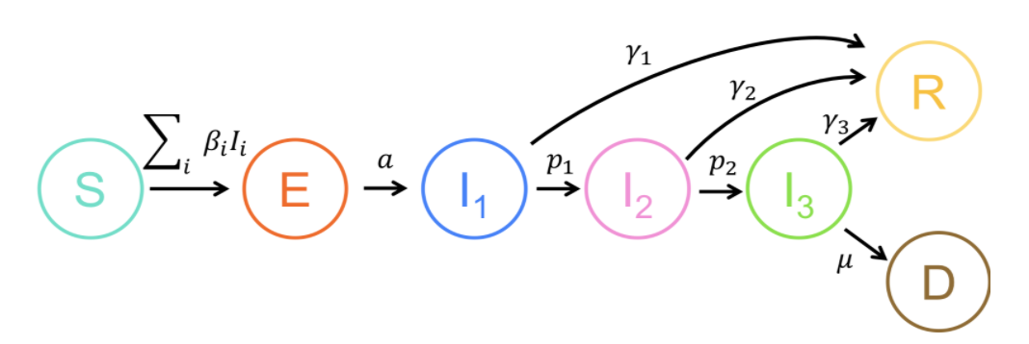
There can be more states of nature
Susceptible
Exposed
Infected – not hospitalized
Infected – hospitalized
Infected – ICU
Recovered
Dead

Slide 34
We will build the SIR model w/beta, gamma & total population
Susceptible
beta
Infected
gamma
Recovered
Beta – rate of infection for the disease
Gamma – rate of recovery/removal

Slide 35
Let’s Practice
C_SIR.R
Haha, misspelled
quarantine!

Slide 36


Thank you.
Ring….Ring…Ring…”Dale the semester is over”
Every student in CSCI-96

